Slide 1
Capstone Engagement
Assessment, Analysis, and Hardening of a Vulnerable System

Slide 2
Table of Contents
This document contains the following sections:
01
Network Topology
02
Red Team: Security Assessment
03
Blue Team: Log Analysis and Attack Characterization
Hardening: Proposed Alarms and Mitigation Strategies
04

Slide 3
Network Topology
‹#›

Slide 4
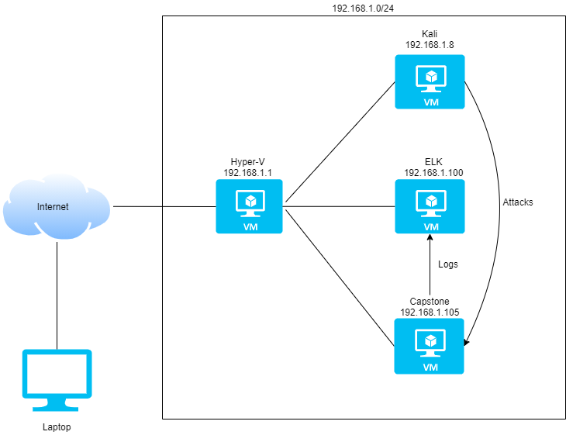
Network Topology
Network
Address Range: 192.168.1.0/24
Netmask: 255.255.255.0
Gateway: 192.168.1.1
Machines
IPv4: 192.168.1.1
OS: Windows
Hostname: Hyper-V
IPv4: 192.168.1.8
OS: Linux
Hostname: Kali
IPv4: 192.168.1.100
OS: Linux
Hostname: ELK
IPv4: 192.168.1.105
OS: Linux
Hostname: Capstone

Slide 5

Red Team
Security Assessment
‹#›

Slide 6
Recon: Describing the Target
Nmap identified the following hosts on the network:
Hostname | IP Address | Role on Network
Hyper-V | 192.168.1.1 | Gateway
Kali | 192.168.1.8 | Attacker machine
ELK | 192.168.1.100 | IDS
Capstone | 192.168.1.105 | Web Server

Slide 7
Vulnerability Assessment
The assessment uncovered the following critical vulnerabilities in the target:
Vulnerability | Description | Impact
Sensitive Data Exposure | Web pages display information that inform attackers of the web servers file structure, username, password hashes and webdav connection instructions | Attackers know where to look for information and are one step closer to gaining access to it
Brute Force Vulnerability | Passwords are not of a sufficient length/complexity and no multi factor authentication is present | Assets that rely on authentication mechanisms can easily be compromised
Unauthorized File Upload | Web users can upload malicious files through the webdav application | Allows an attacker to upload malicious files that can be executed on the server
Remote Code Execution | Web users can execute files that exist on the web server through web browsers | Attackers can execute malicious files (like php reverse shells) to initiate a connection back to the attackers machine

Slide 8
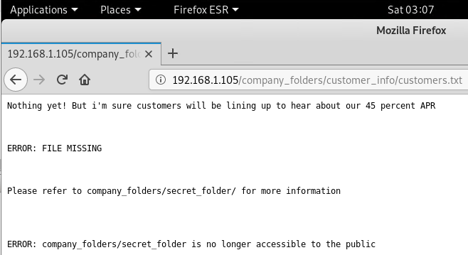
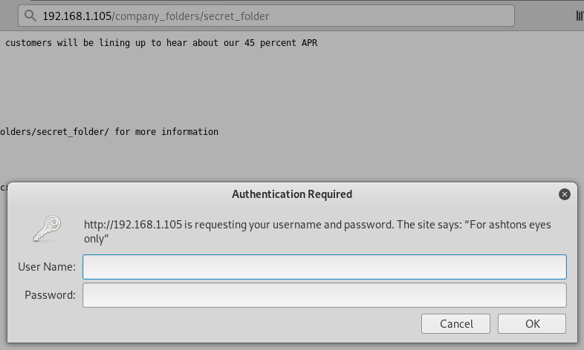
Exploitation: [Sensitive Data Exposure]
01
02
03
Tools & Processes
Used a web browser to access files on the server. Found within these files a reference to a secret folder which when accessed asked for a password and hinted at the required username.
Found webdav username and password hash stored in an unencrypted text file
Achievements
Gained information on the file structure.
Gained username for accessing the secret folder.
Gained webdav connection instructions, username and password hash

Slide 9
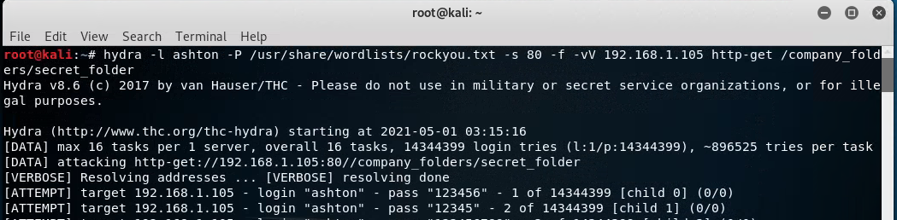
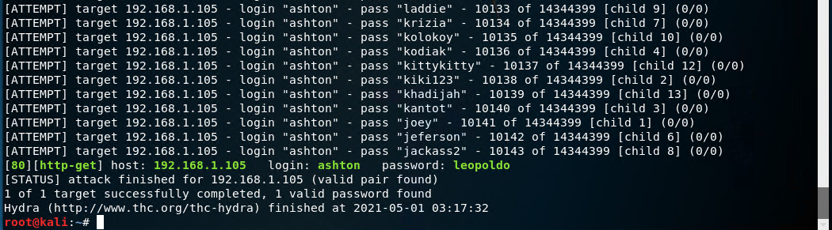
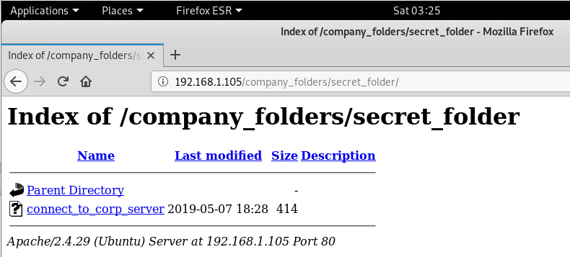
Exploitation: [Brute Force Vulnerability]
01
02
03
Tools & Processes
Used Hydra to brute force the password for username “ashton”
Achievements
Got password for user “ashton” which allowed access into the secret folder

Slide 10
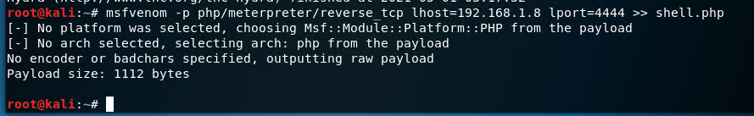
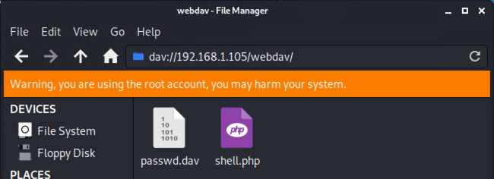
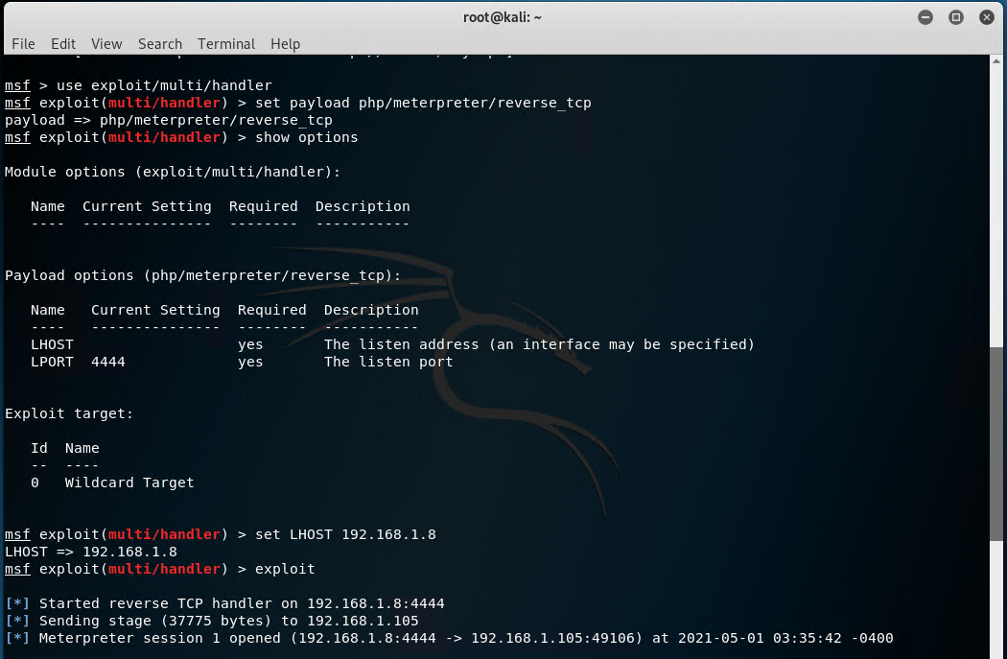
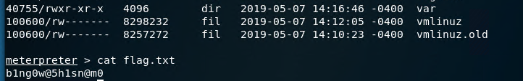
Exploitation: [Remote Code Execution]
01
02
03
Tools & Processes
Crafted a reverse php shell payload using msfvenom.
Uploaded payload to the web server via webdav.
Set up a tcp listener in metasploit
Executed malicious php file in web browser to initiate the connection
Achievements
Granted a user shell in meterpreter and found the flag.txt file

Slide 11

Blue Team
Log Analysis and Attack Characterization
‹#›

Slide 12
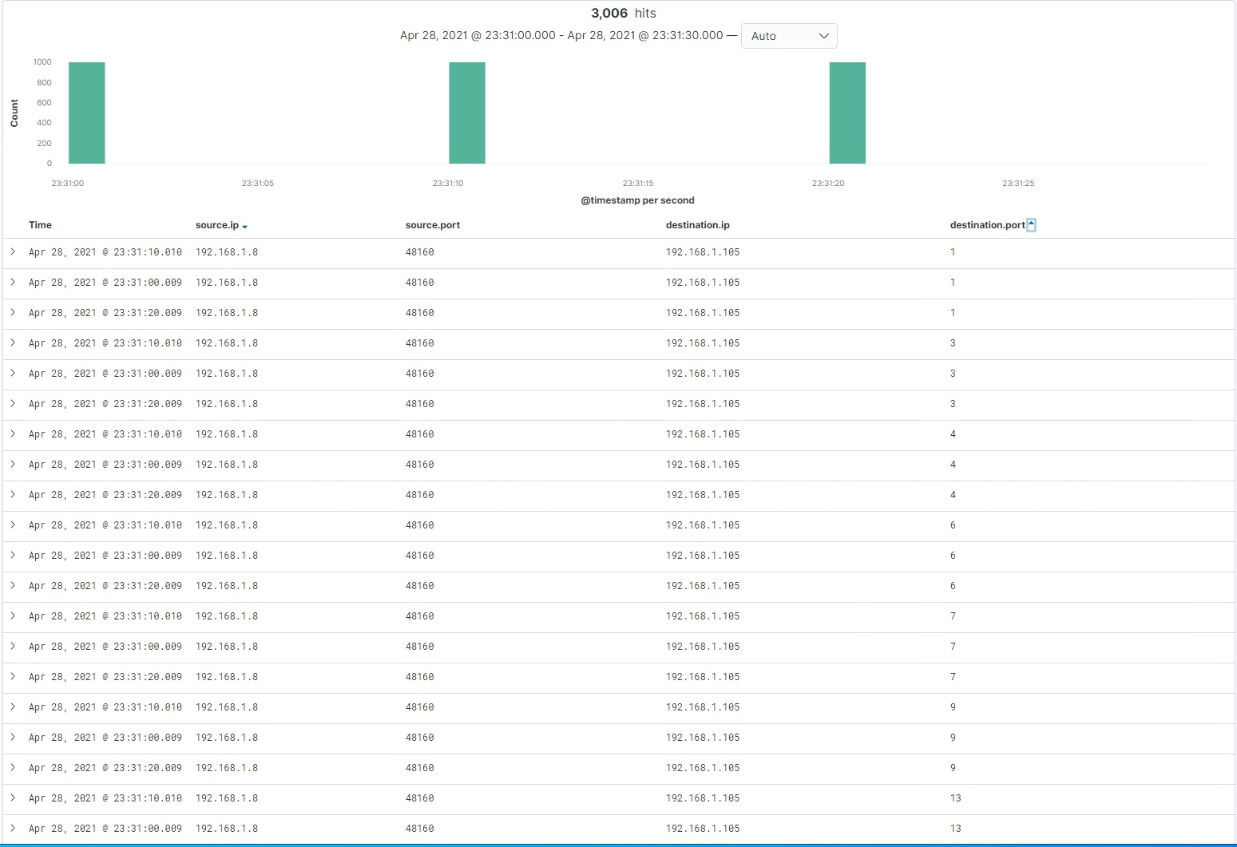
Analysis: Identifying the Port Scan
This data shows the port scan which happened at approximately 23:31 on April 28. 3006 packets were sent from 192.168.1.8 to 192.168.1.105 and we can identify it by the number of different destination present in the traffic

Slide 13
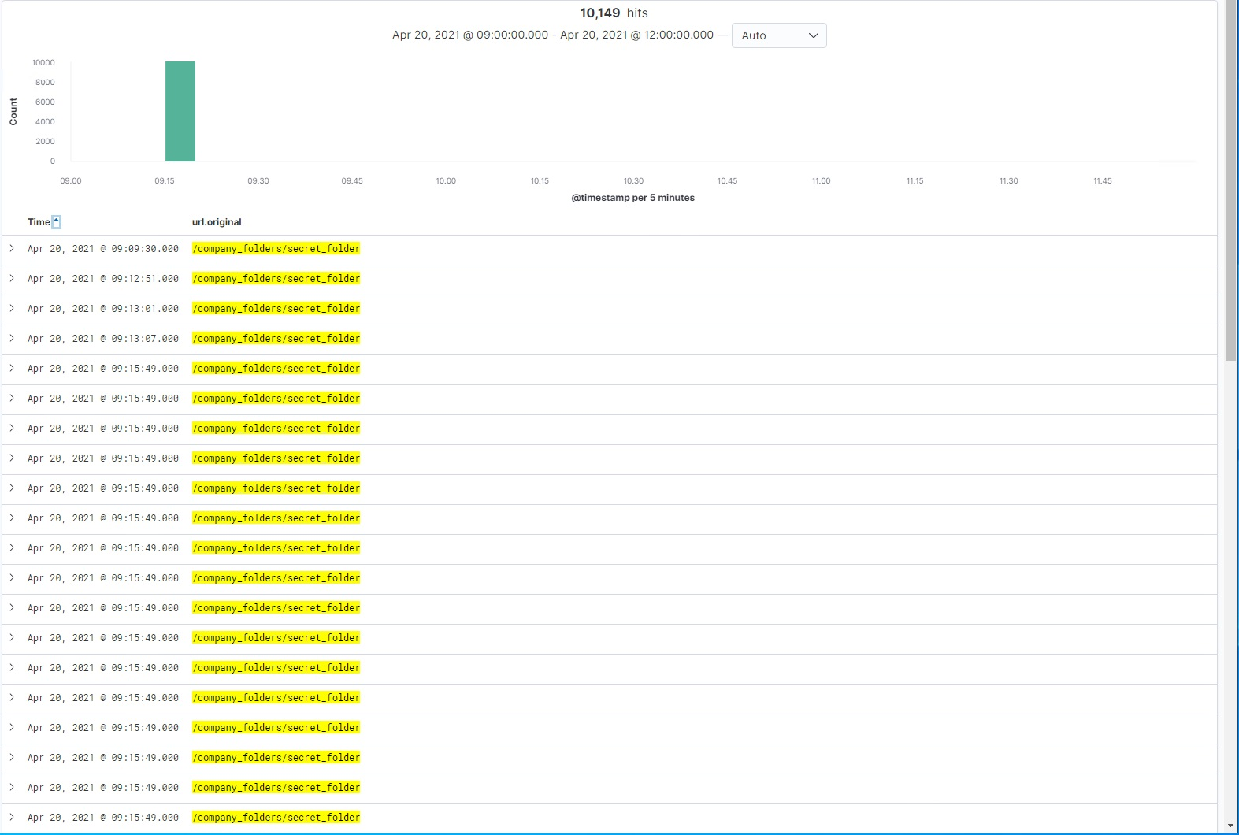
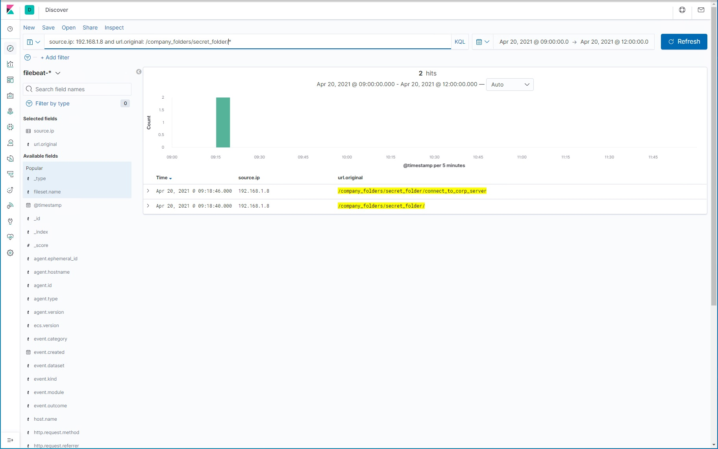
Analysis: Finding the Request for the Hidden Directory
We can see on the left requests for the hidden directory were made at 9:09:30, approximately 5 minutes before the brute force attack happened. On the right, we see the file that was accessed inside that directory, connect_to_corp_server

Slide 14
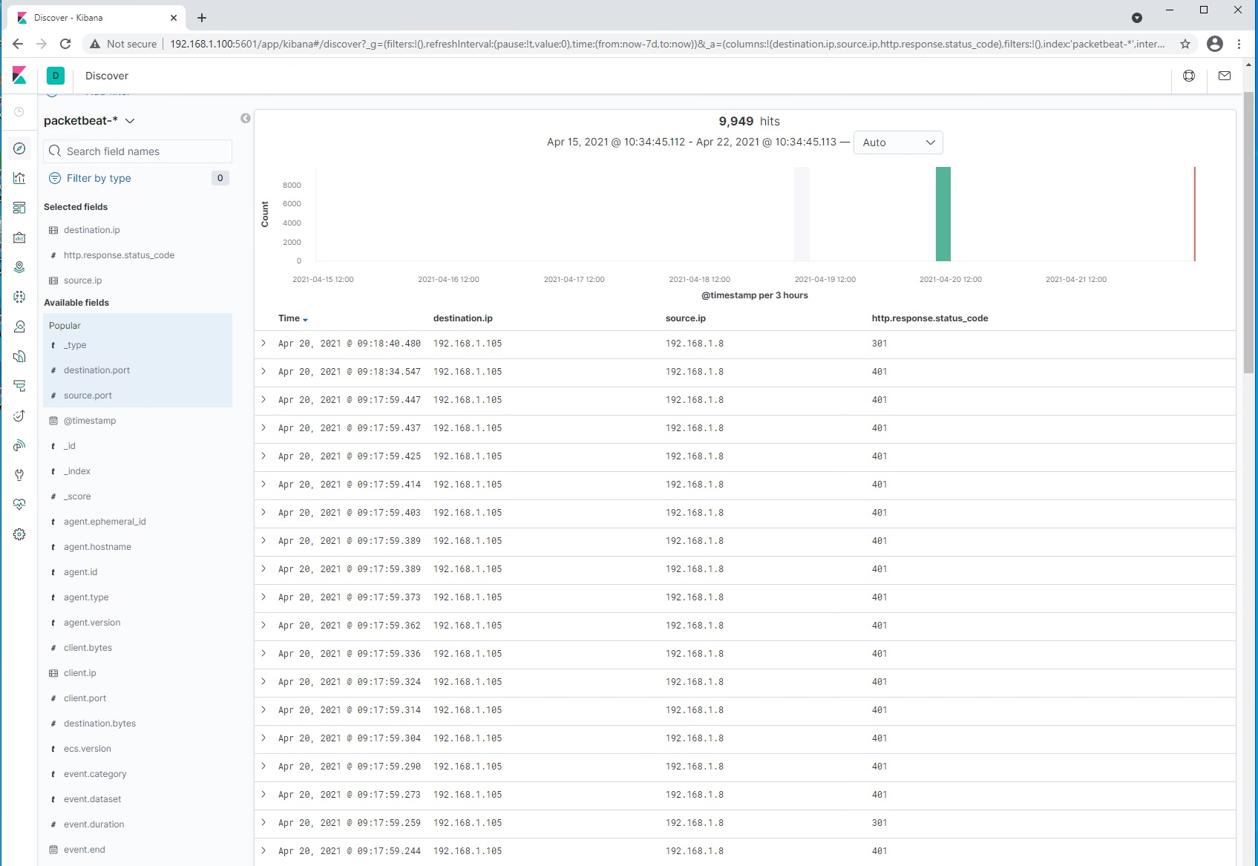
Analysis: Uncovering the Brute Force Attack
9949 attempts were made to brute force the password at approximately 09:17 on April 20

Slide 15
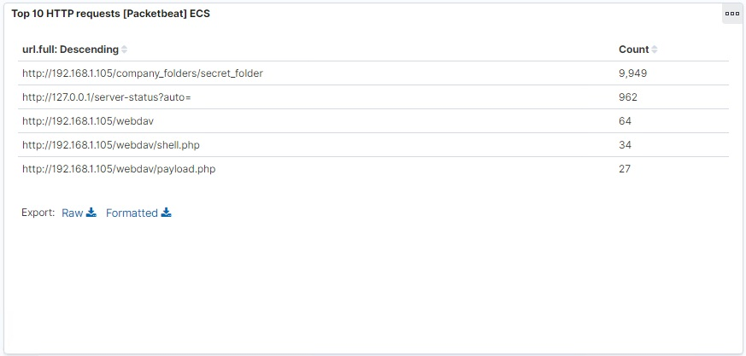
Analysis: Finding the WebDAV Connection
Here we see evidence of the webdav connection and the files that were accessed, shell.php and payload.php

Slide 16
Blue Team
Proposed Alarms and Mitigation Strategies
‹#›

Slide 17
Mitigation: Blocking the Port Scan
We can count the number of different destination ports a single remote source is trying to connect to our server on in a short timeframe(per second)
Common practice is to set the threshold for this alarm at around 100 per second to detect port scans
Once this alarm has been triggered, set up your firewall or IPS to drop packets from the remote source

Slide 18
Mitigation: Finding the Request for the Hidden Directory
If we merely want to know who is trying to access this directory, we can set an alarm with a threshold of 1 any time the url requested is /secret_folder
Obviously this would include authorized users as well so practically we might want to include the http response code 401 to filter them out
Whitelist known addresses from legitimate sources, or use a VPN
We can also use Multi Factor Authentication and enforce strong passwords to reduce unauthorized access

Slide 19
Mitigation: Preventing Brute Force Attacks
We can count the number of 401 http response codes (Unauthorized access) for a single remote source
Setting this threshold at 10 per second will discover brute force attempts quickly, without creating any false positives
Similar to the port scan we can set up our firewalls/IPS to drop packets from remote sources that trigger the alarm
Account lockouts with progressive delays also protect user accounts from this attack but introduce the possibility of denial of service to them

Slide 20
Mitigation: Detecting the WebDAV Connection
Detecting the webDAV connection is as simple as monitoring requests to the webdav directory with http response codes of 200
1 result indicates a connection
We can enable webdav access control policies that restrict what files and folders groups of users can see and what privileges they have (read, write, delete)
Going further, we can whitelist an ip address associated with a known user and/or use VPN

Slide 21
Mitigation: Identifying Reverse Shell Uploads
In order to detect uploads we need to monitor POST http methods to the desired folder
A single POST event indicates a file was uploaded
We can protect against this attack by defining valid types of files that users can upload
Furthermore, if we store uploaded files in a location that is not web accessible then attackers cannot initiate the reverse shell connection even if they manage to upload it

